Slide 1
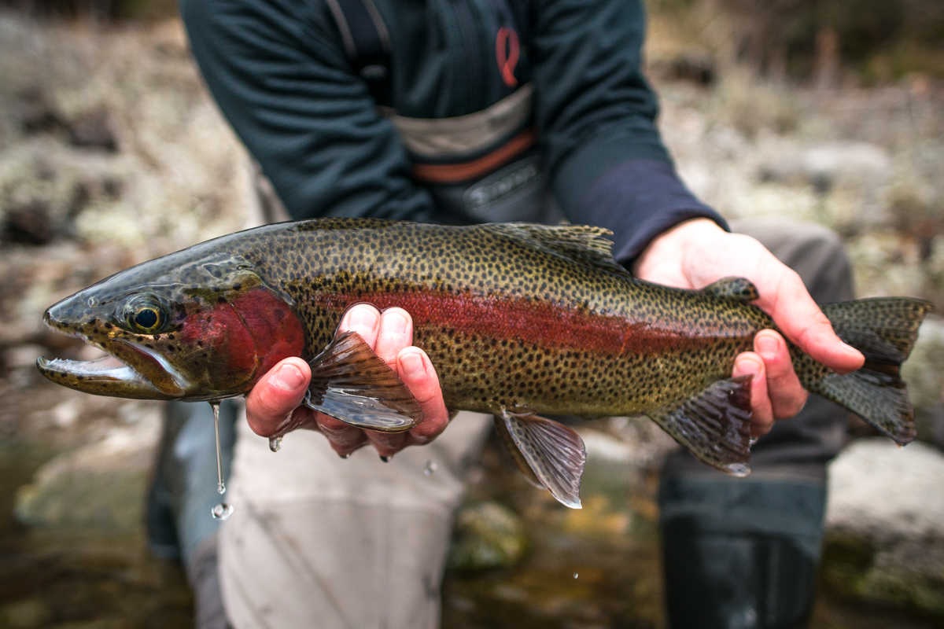


Redband Trout and Climate Change
Developed by
The Spokane Riverkeeper and
Center for Climate, Society, and the Environment

Slide 2

Big Question
How do changes in water level in the Spokane River affect trout eggs and the survival of the Redband Trout?
Notes:
Give an overview of the workshop

Slide 3
Key Terms
Redband Trout: A wild native fish that lives in the Spokane River that is a species of concern.
Habitat Destruction: the process by which a natural habitat becomes unable of supporting its native species.
Redd: a spawning nest made by a fish
Cubic Feet Per Second: A measurement of how much water is flowing a river at one time.
Climate Change: a change in the regional climate pattern that can lead to hotter temperatures and drought.

Slide 4
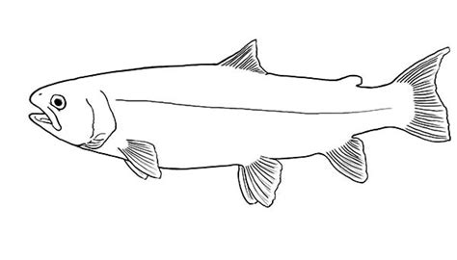
Redband Trout Anatomy
Dorsal Fin
Caudal Fin
Adipose Fin
Nostril
Eye
Lateral Line
Mouth
Gills
Pectoral Fin
Anal Fin
Pelvic Fin

Slide 5
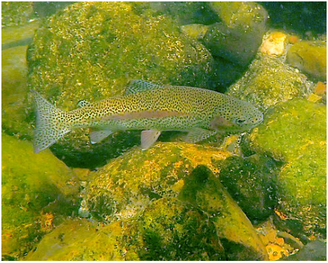
Color your Redband Trout!
Photo by Tim Connor

Slide 6
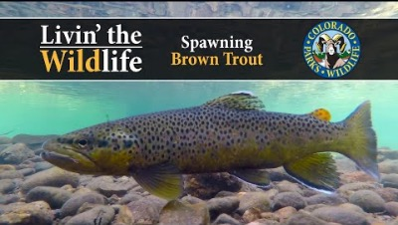

Slide 7
What do you remember?
Where do trout lay their eggs?
  In shallow holes in gravel on the sides of a river
What is a trout nest called?
  A redd
What do redds need for the trout to hatch?
  Water!
Notes:
Trout in the Spokane River dig shallow holes with their tails called redds to lay their eggs in.
The eggs and redds are built in river gravel in less than 8 feet of water, ear the edges of the river.
The redds need to be covered in water until the eggs hatch and the fish swim into the river.
Climate change is changing the river flows across the Northwest. The rivers have lots of water early in the winter and less water in early spring than they used to.

Slide 8
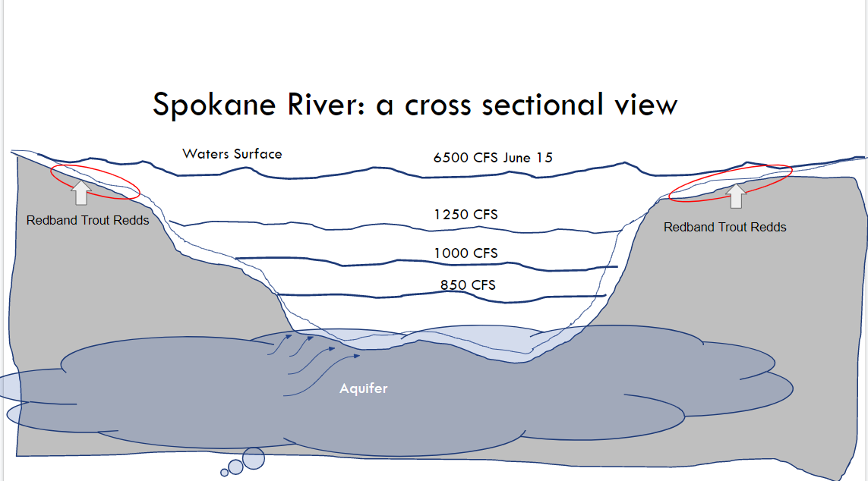
How much water is flowing in the Spokane River?
CFS: Cubic Feet Per Second
Redband Trout eggs need to be covered by water to survive.
Redband Trout redds hatch around June 15th. This means they need to be covered by water until at least June 15th.
Where is 6500 CFS on the picture?
What does that mean?
Where would the water level be if the river was flowing at 1000 CFS?
Notes:
As you ask questions, have students come up and point to the line and have them explain their answer

Slide 9
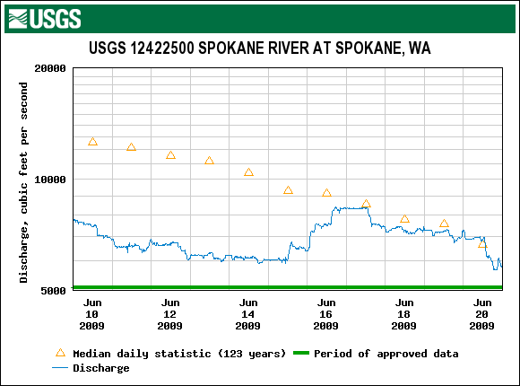
Water Flow in the Spokane River in 2009
What was the water flow on June 15th?
Did the Redband Trout eggs survive this year?
Why or why not?
Notes:
Working in pairs, each group of students should analyze the data in the graph to see what the water level was on the six days in June of 2009.
What was the water flow on June 15th?
Did the trout eggs survive in 2009?

Slide 10
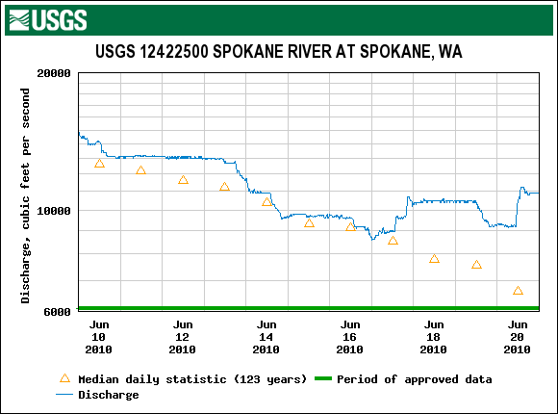
Water Flow in the Spokane River in 2010
What was the water flow on June 15th?
Did the Redband Trout eggs survive this year?
Why or why not?

Slide 11
Stand- Up Quiz
Where do trout lay their eggs?
  In gravel on the sides of a river
  In gravel at the bottom of a river
  On the plants that grow in a river
  In a tree
Notes:
Teachers can utilize a standing quiz to get students on their feet and moving around for a few minutes.
Explain that each corner is a letter, A B C or D
Tell them to go to the letter they think is the correct answer

Slide 12
Stand- Up Quiz
What is this part of a fish called?
  Nostril
  Dorsal Fin
  Pectoral Fin
  Lateral Line
Notes:
Teachers can utilize a standing quiz to get students on their feet and moving around for a few minutes.
Explain that each corner is a letter, A B C or D
Tell them to go to the letter they think is the correct answer

Slide 13
Stand- Up Quiz
How much water is needed in the River for Trout Redds to survive?
  850 CFS
  1000 CFS
  1200 CFS
  6500 CFS
Notes:
Teachers can utilize a standing quiz to get students on their feet and moving around for a few minutes.
Explain that each corner is a letter, A B C or D
Tell them to go to the letter they think is the correct answer

Slide 14
Stand- Up Quiz
What happens to the trout eggs if there isn’t enough water?
  They turn into frogs and live on land
  The eggs roll to find more water
  They dry out and die
  They hatch early
Notes:
Teachers can utilize a standing quiz to get students on their feet and moving around for a few minutes.
Explain that each corner is a letter, A B C or D
Tell them to go to the letter they think is the correct answer

Slide 15
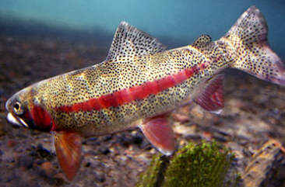
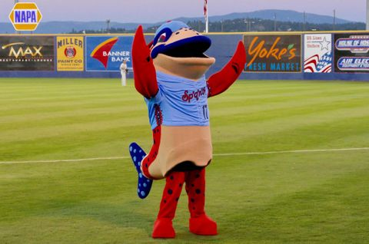
Why do we care about Redband Trout?
Notes:
Redband Trout are native to Spokane
They are even the mascot for the Spokane Indians baseball team!
Redband trout populations are decreasing due to habitat destruction, lower water levels in rivers, and warmer water.
There are less redband trout than other trout species in our area, and the Fish and Wildlife service has listed them as a species of concern, meaning we’re worried about them because they are threats to their survival
What are some ways you think you might be able to help Redband Trout survive?
Save water at home by not letting the water run when you brush your teeth
Take shorter showers
In the spring, make sure you watch where you walk if you visit the Spokane River.
Talk to your family or people at home about the Redband Trout!

Slide 16
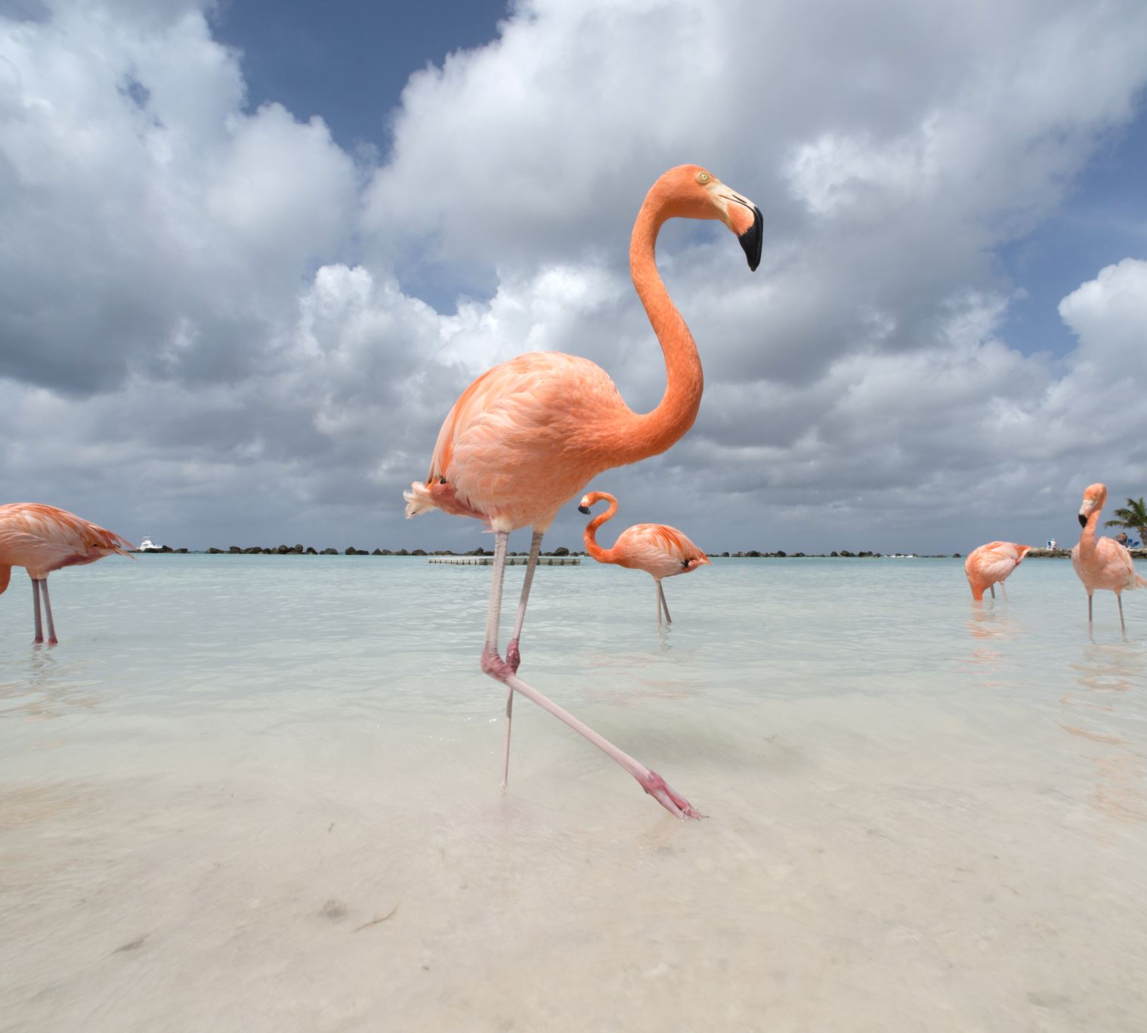
Warmer Waters
The water in the Spokane River might be getting warmer!
Climate change can cause warmer weather and less precipitation.
How do fish breathe underwater?
What do you think will happen to fish if the water gets too warm?
Notes:
We think water temperature may be increasing in the Spokane River. Increasing air temperatures and lower water flows can lead to increased water temperature. Let’s look at the temperature of the Spokane River over the last five years. Our water temperature data shows high temperatures in the Spokane River from 2015-2020.
High water temperatures kill trout and have other negative consequences.
Fish breathe underwater by pulling oxygen out of the water. Did you know that warm water has less oxygen than cold water?
What do you think will happen to fish if the water gets too warm?

Slide 17
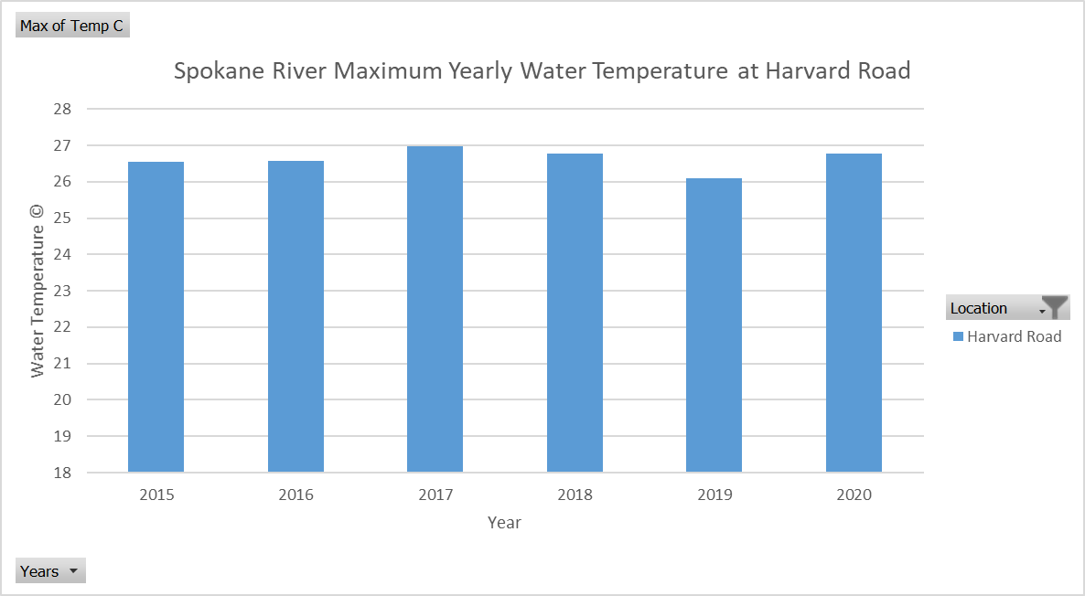
How warm is the Spokane River?
Notes:
The water quality standard for maximum temperature is 18 C (64 F). A water quality standard is the ideal condition for a body of water. This means that the ideal temperature for the Spokane River is 18 degrees Celsius or 64 degrees Fahrenheit
What is the maximum water temperature recorded on the graph below?
Was temperature of the water in 2020 at the ideal temperature?
Was the water temperature in 2020 ideal for redband trout?

Slide 18
Big Question
How do changes in water level in the Spokane River affect trout eggs and the survival of the Redband Trout?
Notes:
Give an overview of the workshop

Slide 19
One Word Sharing
Everyone gets to say one word about how they feel after learning about Redband Trout!
Here are some examples of what you can say:
  Excited
  Fishy
  Curious
  Smart
  Scientist

